Slide 1
Venture Funding 101
Startups
Joe James
Math & Computer Science Tutorials
from Silicon Valley

Slide 2
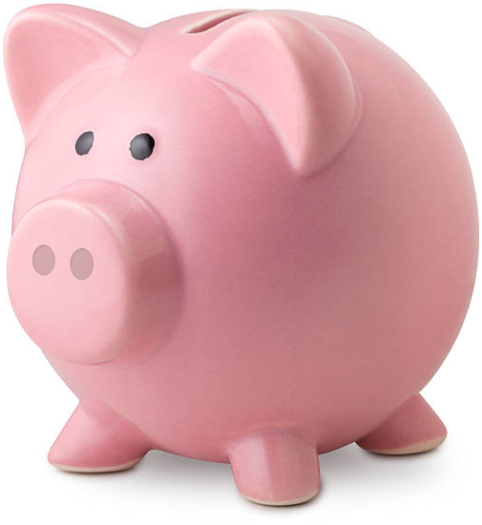
Bootstrap
Bootstrap means the company is funded by personal savings until the company has a profit stream
No outside investors
Product Idea -> Work on product implementation

Slide 3



Incubators and Accelerators
Incubators and Accelerators provide resources to startups such as
Legal services
Marketing support
Management mentorship
Co-working space
Access to Angel investors
Incubators - very early stage startups
Accelerators - startups in all stages

Slide 4
Seed
Define Product, Market, and Customer Base
Get working product to market
Friends & Family (14%)
Set aside Option Pool shares, reserved for employees. Early employees get stock options that will be valuable if the company succeeds.
Founder (30%)
Option Pool (13%)
Angels (13%)
Seed funding supports a few more employees beyond co-founders
$500k to $2M funding round led by Angel investors
CoFounder (30%)

Slide 5
Series A
Scale user base geographically or into new verticals
Figure out how to monetize product
Friends & Family (11%)
Founder (23%)
Early stage VCs provide capital to hire employees and management guidance to help the startup succeed.
Option Pool (12%)
Angels (11%)
CoFounder (23%)
Series A venture capital investors invest ~$10M in exchange for ~20% of the shares
$5M to $15M funding round led by early stage VCs
VC (20%)

Slide 6
Series B
Scale User Base and Revenue
Expand products, sometimes through acquisitions
Friends & Family (9%)
Option Pool (10%)
Founder (21%)
Angels (9%)
Investments both from Series A VCs and from later stage investors
$5M to $50M funding round
CoFounder (21%)
VC (30%)

Slide 7
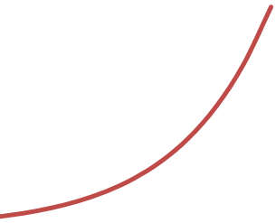
Series C & D
Possible if startup needs additional capital to fund growth or acquisitions
Sometimes used to pull in new VCs for their value as advisors
Typical funding in C & D rounds is $10M+, from later stage VCs

Slide 8


A “Liquidity Event”
The exit strategy of most startups is to either be acquired or IPO
Both outcomes enable shareholders to cash out

Slide 9
Control vs Equity
The Founder may end up with less than 20% of the shares, meaning he has less control over the company
He gives up control in exchange for the capital needed to scale the business
The pie gets much bigger as the company gets traction. He gets a smaller slice of a bigger pie.

Slide 10

© 2017 Joe James

